Slide 1
Train Booking Web App

Slide 2
Project objective
To Create a Web Application where User can Book Online Train Tickets.

Slide 3
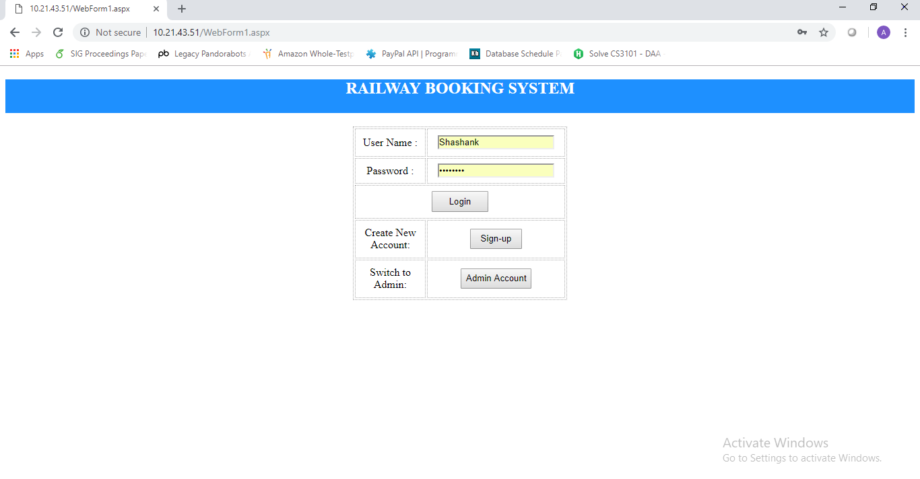
-->We can see that it is Deployed in Server.
-->IIS Server is used and corresponding inbound rules are adjusted.
-->Customer can Login into Website by his/her Account
-->Interface for Admin Accounts is Also provided.
-->Customer can Sign-up if they need with new account and data is safely stored in DataBase.

Slide 4
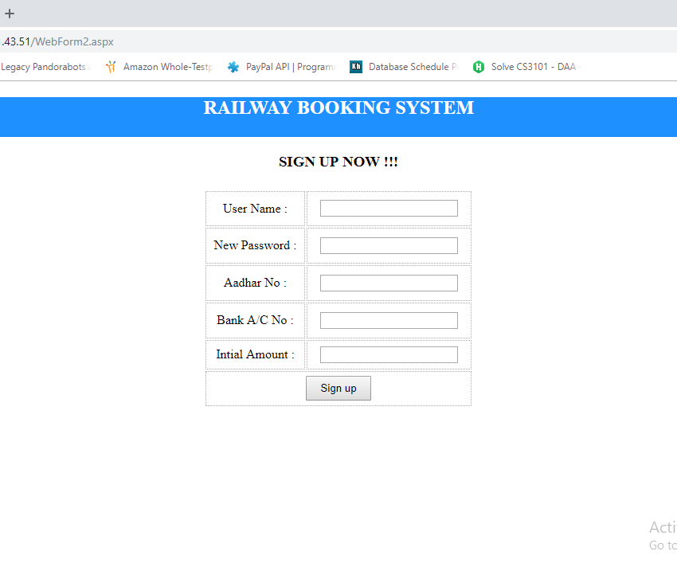
-->This Page is given user when he is first entered into System
--->After sign up he his details were entered into Database and allow him to log in .

Slide 5
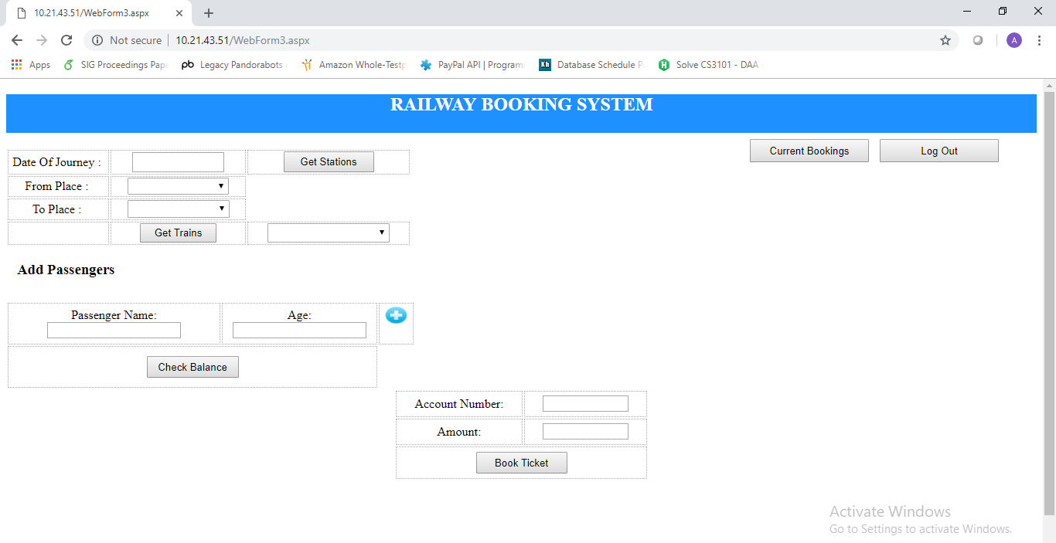
Description is Given in Next Slide

Slide 6

-->Firstly, Date of Journey is Decided by the user.
-->Then From and To Stations are Selected by Getting Stations.
-->Now with Date and places Sorted Trains can be Selected by Getting Trains.
-->After Choosing Date,Places,Train then user may Add Passengers, Multiple Passengers are allowed Ticket uniqueness is Maintained by Ticket-ID and Main Passenger Data also Stored in Database along with other Details.
-->Before Committing Transaction user can Check Balance Along with Ticket Amount.
-->Account number need to be provided for Transaction and Message is shown after secure Transaction.
--->User Can Check is Previous Bookings Done with this Account.
-->User Can Log Out If user wants and can Redirect to Login Just in Case user wants.

Slide 7
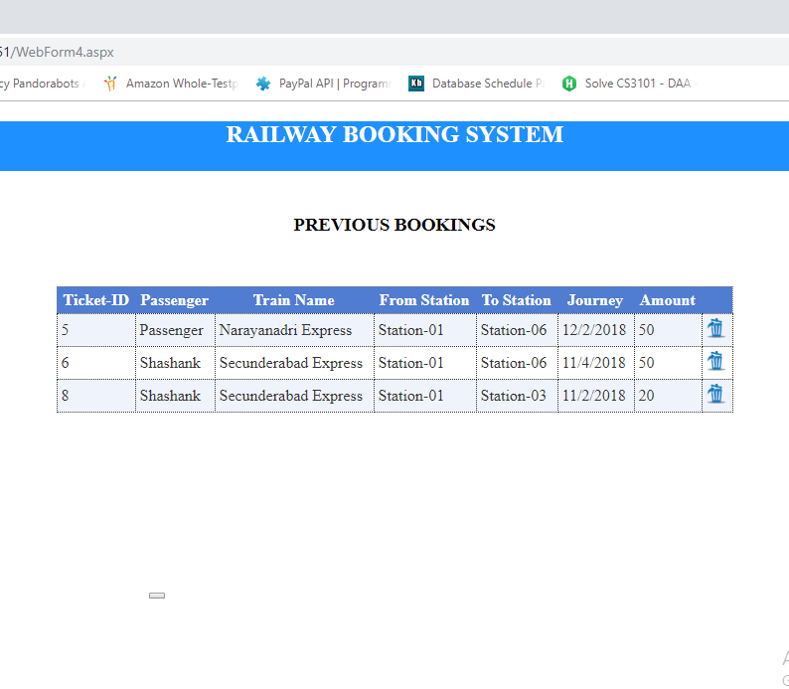
--->Previous booking were shown as Ticket ID as the key.
--->After Deletion amount will be refunded back to the account.
-->Log Out is available if user wants to end session.

Slide 8
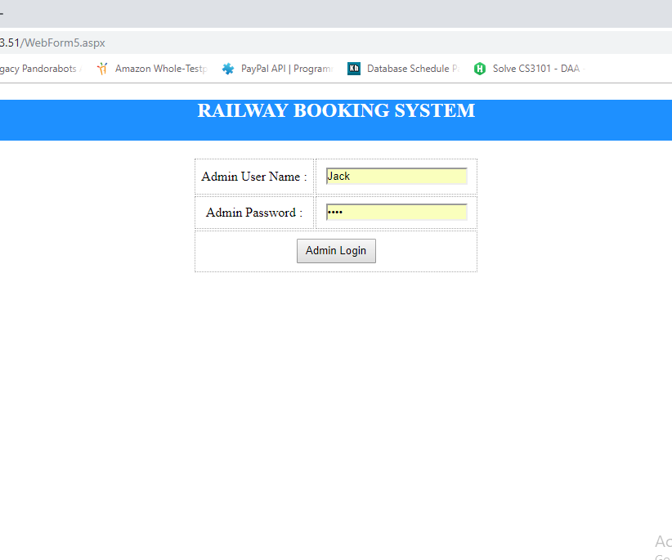
-->Admin Account Can be Logged in With Appropriate Account Authentication.

Slide 9
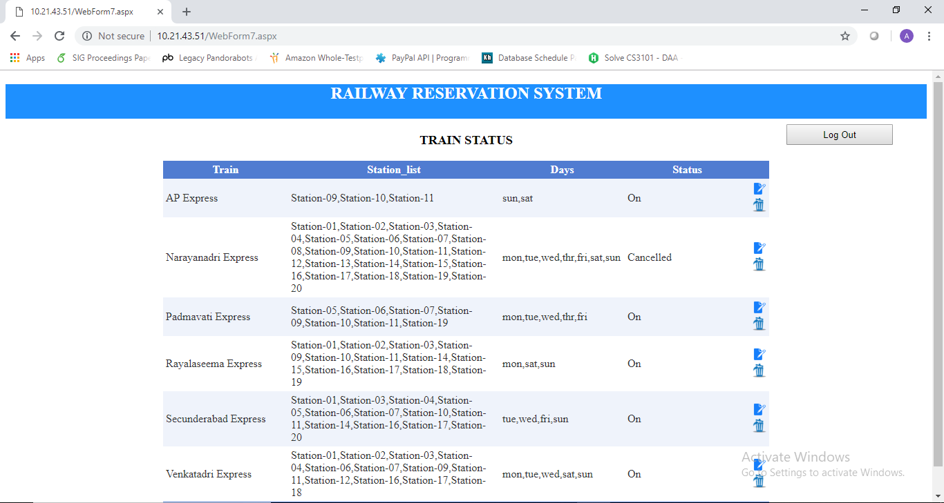
-->Display of All STrains available where Admin Can Edit,Update,Delete and Save Changes into Database
-->Cancelled or Deleted Stations,Train and Days will no more in access of any user.
-->Admin Can Log Out After his/her Desired Changes.

Slide 10
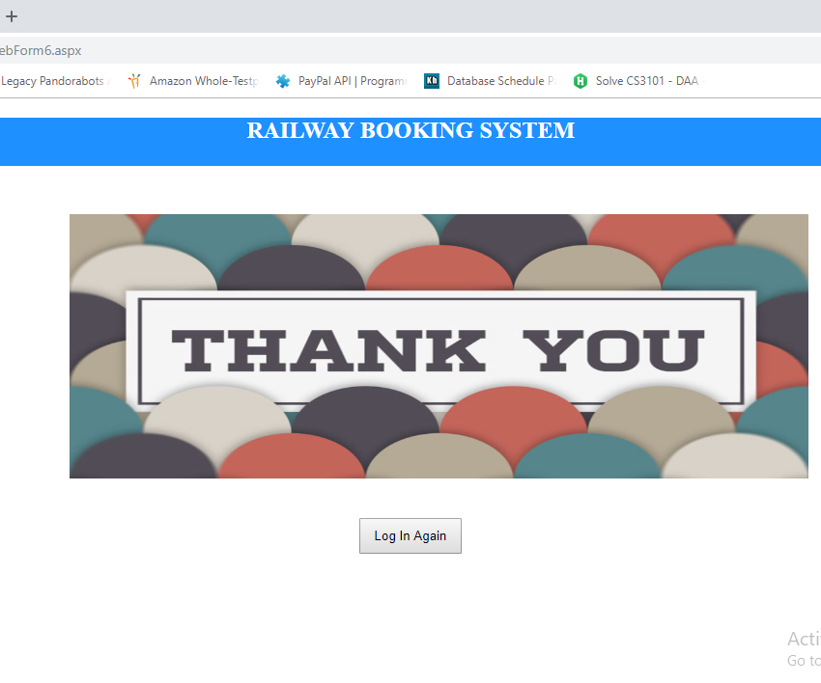
-->A Sweet Sign Off Page but can Login into Different account if user/admin wants to.

Slide 11

Thank you!

